Slide 1
Kaggle Contest: M5 Forecasting
Group members:
CHAN Koon Lam 20748995 (1st presenter)
TANG Tsz Hong 20735194 (2nd presenter)
LAM Chung Wai 20430732 (3rd presenter)
Notes:
Background+data peter
Feature selection +evaluation jason
model +result + conclusion walter

Slide 2

Background
Why it is called M5 forecasting?
the fifth competition held by Makridakis Open Forecasting Center (MOFC) -
The aim of the competition
use the hierarchical sales data from Walmart
1. estimate the daily sales for the next 28 days
2. estimate uncertainty of the daily sales for the next 28 days
Notes:
calander.csv
wday:
It means weekday. Saturday refers to 1, Sunday refers to 2, etc.
The main reason of choosing 1 as Saturday is because the first day in dataset, 2011-01-29, is a Saturday.
wm_yr_wk:
It is id of the week. It corresponds to last two digit of the year, and the number of week in that year.
Notice that first week started on 2011-01-29, start counting the 52 weeks for 2011.

Slide 3
Data Description
Before start our analytics, it is always useful to understand the data first.
Dataset 1: calendar.csv
contain detailed date information of all the 1969 dates
starting from 2011-01-29 to 2016-06-19
Dataset 2: sell_prices.csv
contain information about price and type of products
Dataset 3: sales_train_validation.csv ,and sales_train_evaluation.csv
after splitting the date by time, it would be the training set, validation set and test set
contain the time series data that indicate how many items are sold everyday
Notes:
Before start our analytics, it is always useful to understand the data first.
calendar.csv
It is the dataset contain detailed date information of all the 1969 dates, starting from 2011-01-29 to 2016-06-19.
sell_prices.csv
It is the dataset contain information about price and type of products.
sales_train_validation.csv ,and sales_train_evaluation.csv
They are the training set and test set. They contain the time series data that indicate how many items are sold everyday.

Slide 4
Data Description - calendar.csv
Dataset 1: calendar.csv (date information)
wday
saturday refers to 1, sunday refers to 2, etc.
the main reason of choosing 1 as Saturday is because the first day in dataset, 2011-01-29, is a Saturday.
wm_yr_wk
id of the week
corresponds to last two digit of the year, and the number of week in that year.
notice that first week started on 2011-01-29, start counting the 52 weeks for 2011.
Notes:
calander.csv
wday:
It means weekday. Saturday refers to 1, Sunday refers to 2, etc.
The main reason of choosing 1 as Saturday is because the first day in dataset, 2011-01-29, is a Saturday.
wm_yr_wk:
It is id of the week. It corresponds to last two digit of the year, and the number of week in that year.
Notice that first week started on 2011-01-29, start counting the 52 weeks for 2011.

Slide 5
Data Description - calendar.csv
Dataset 1: calendar.csv (date information)
snap_CA, snap_TX, and snap_WI
binary variable
1 indicates that SNAP purchases are allowed, 0 otherwise.
SNAP is a short-form of Supplement Nutrition Assistance Program
a nutrition assistance benefit provided by the United States federal government
Notes:
snap_CA, snap_TX, and snap_WI
It is a binary variable. 1 indicates that SNAP purchases are allowed, 0 otherwise.
SNAP is a short-form of Supplement Nutrition Assistance Program. It is a nutrition assistance benefit provided by the United States federal government.

Slide 6
Data Description - calendar.csv
Dataset 1: calendar.csv (date information)
event_type_1 & event_type_2 and event_name_1 & event_name_2
contains the event of that date
The last digit in the column names, 1 and 2, refers to the first event and the second event on that date.
four types of events : Sporting, Cultural, National, Religious
Sporting: SuperBowl, NBAFinalsStart, NBAFinalsEnd
Cultural: Valentines Day, StPatricks Day, Halloween, Easter
National: Presidents Day, Independence Day, LaborDay
Religious: LentStart, Purim End, Ramadan starts
Notes:
event_type_1 & event_type_2 and event_name_1 & event_name_2
It contains the event of that date. The last digit in the column names, 1 and 2, refers to the first event and the second event on that date.
For event type, the four types of event are Sporting, Cultural, National, Religious respectively. The following shows some of the event name of each event types.
Sporting: SuperBowl, NBAFinalsStart, NBAFinalsEnd
Cultural: Valentines Day, StPatricks Day, Halloween, Easter
National: Presidents Day, Independence Day, LaborDay
Religious: LentStart, Purim End, Ramadan starts

Slide 7
Data Description - sell_prices.csv
Dataset 2: sell_prices.csv (sales information)
store_id
4 stores in California (CA), 3 stores in Texas (TX) and 3 stores in Wisconsin (WI)
denoted as CA_1, CA_2,...,TX_1,...,WI_3
sell_price:
the price of the product for the given week or store
This price is provided on weekly basis
In other words, it takes the average across seven days.

Slide 8
Data Description - sales_train.csv
Dataset 3: sales_train_validation.csv / sales_train_evaluation.csv (training set and test set)
dept_id
the department of the item came from
three major categories Hobbies, Household, and Food
seven departments HOBBIES_1, HOBBIES_2, HOUSEHOLD_1, HOUSEHOLD_2, FOODS_1
item_id
id of every unique item. There are 30490 different items in total.

Slide 9
Data Description - Combining the datasets
The three datasets are combined by the key, “d”, which indicates the day from day 0
The merged df has shape (59181090, 8)
It is then split into training set, validation set, test set.
training set: d_1 to d_1913 (2011-01-29 ~ 2016-04-24)
validation set: d_1914 to d_1941 (2016-04-25 ~ 2016-05-22)
test set: d_1942 to d_1969 (2016-05-23 ~ 2016-06-19)

Slide 10
Feature Engineering

Slide 11
Feature Engineering
an important aspect in machine learning
process of using domain knowledge to translate raw data into features
=> increase the prediction power of the model
For a data scientist, over 60% of time is organising the data, including Feature Engineering.
Introduce Feature Engineering in two aspects
1. Exploratory Data Analysis
2. What feature we have added

Slide 12
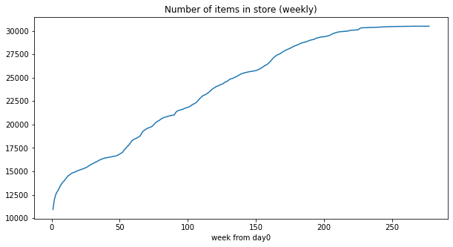
Feature Engineering - EDA
Exploratory Data Analysis (EDA) is useful to get an overview of how the data behaves
visualization and statistical technique will be used in this stage
We plot the number of item sold in store every week. It shows an increasing trend.
Customers can reach more variety of items => increase their chance of purchasing.

Slide 13
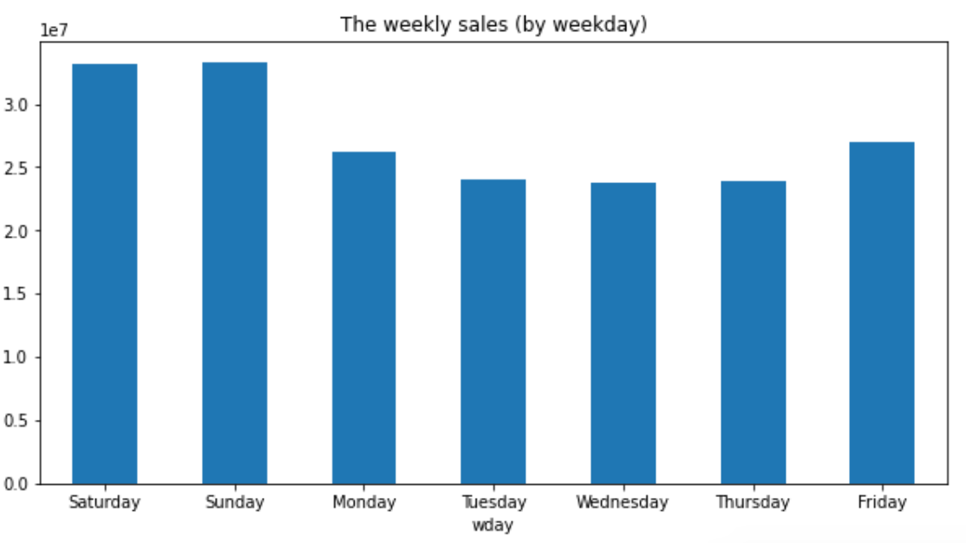
Feature Engineering - EDA
Clearly the sales amount in weekend is much higher than in weekday.

Slide 14
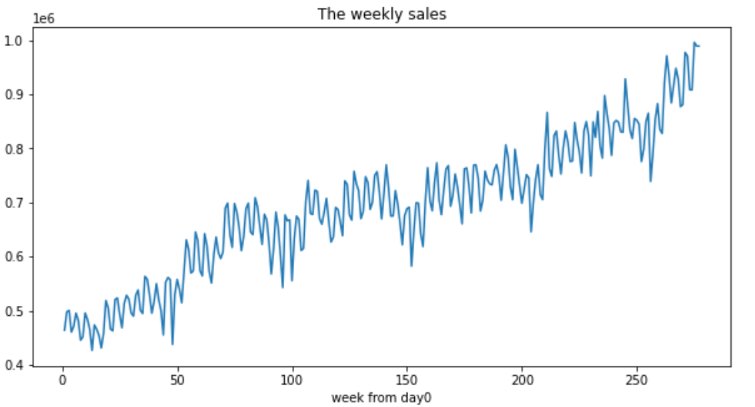
Feature Engineering - EDA
The weekly sales trend also increases by time.
One of the reason is Inflation, the item price increases, thus lead to the sales increase.

Slide 15
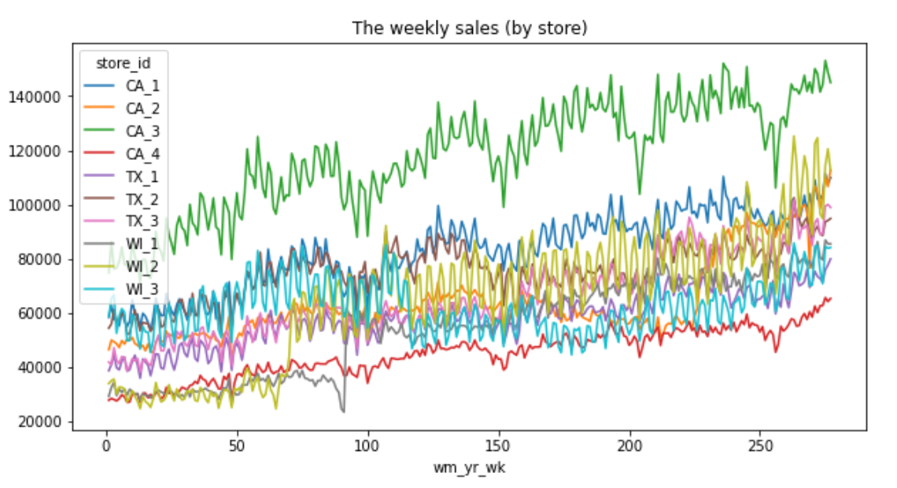
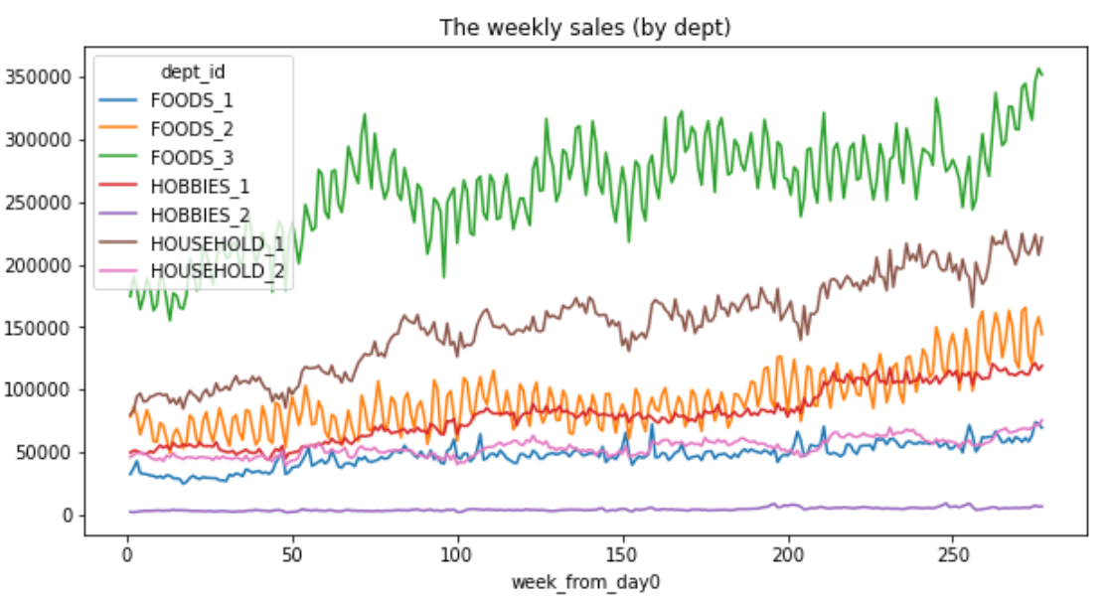
Feature Engineering - EDA
The sales data by store, or by dept have similar trend of the previous slide

Slide 16
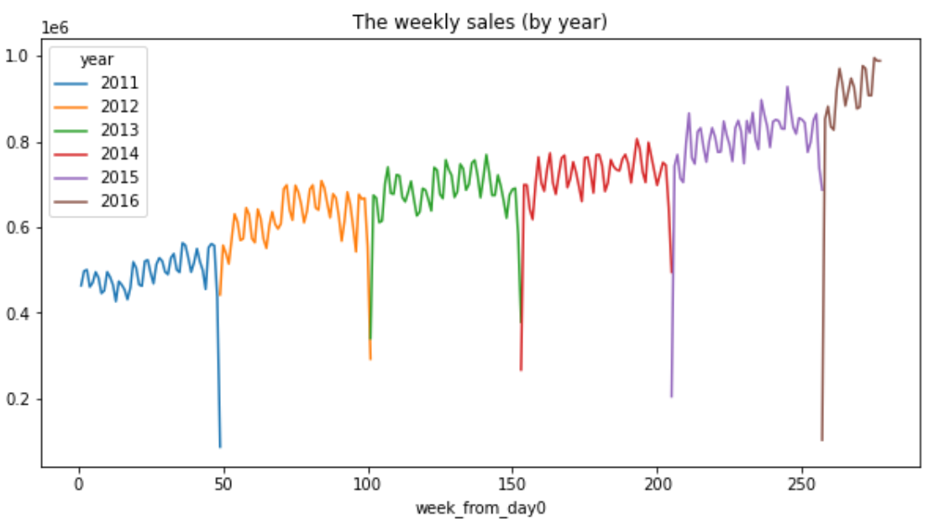
Feature Engineering - EDA
Increasingly, there are about 12 spikes every year, and their shapes are similar to each other
seems that it has some seasonal trend

Slide 17
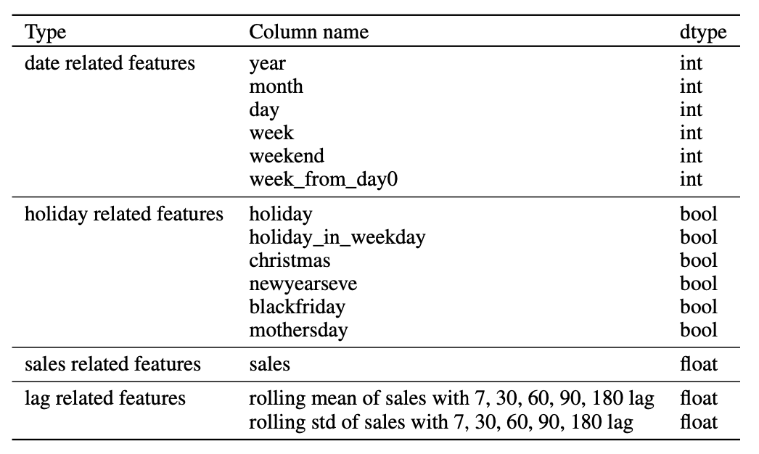
Feature Engineering – adding new features
Based on the previous analysis, we believe that the data has some repetitive trend by time
By our domain knowledge, we know U.S. citizens are willing to spend money on holidays
=> we added holiday related features eg holiday in weekday, christmas etc
lag features
rolling mean and std of sales
7, 30, 60, 90, 180 lag (weekly, monthly, bimonthly etc)
they are useful in predicting time series data

Slide 18
Evaluation Metrics

Slide 19
Evaluation Metrics
Instead of using the common ways of model evaluation techniques in Machine Learning
AUC curve, ROC curve, Confusion Matrix or the Root Mean Square Error (RMSE)
The organizer MOFC used other evaluation approaches
WRMSSE and WSPL
= score obtained on Kaggle
Lower score => better prediction
Although it is not included in our model training part
i.e we are using Root Mean Square Error (RMSE)
it is good to know how the final evaluation works
Notes:
WRMSSE: Weighted Root Mean Squared Scaled Error
WSPL: Weighted Scaled Pinball Loss

Slide 20
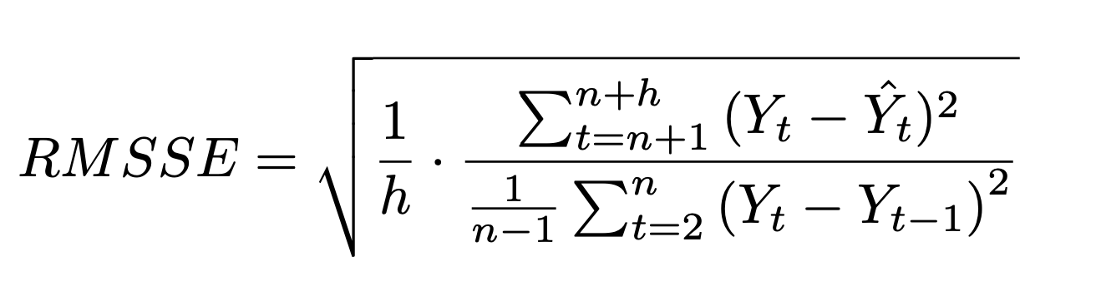
Evaluation Metrics
For the Accuracy contest,
the forecasts will be evaluated using the Root Mean Squared Scaled Error (RMSSE)
The formula is as follows
where n denote the length of the training sample, h is the forecasting horizon
The final Kaggle score is determined by Weighted RMSSE (WRMSSE)
Lower WRMSSE score => better prediction

Slide 21
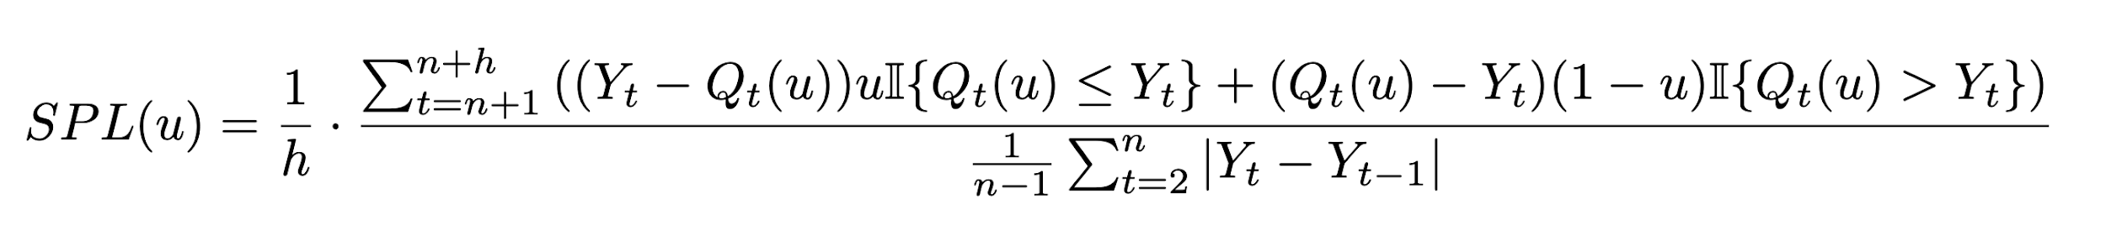

Evaluation Metrics
For the Uncertainty contest,
It will be evaluated using the Scaled Pinball Loss (SPL) function.
where is the the forecast for quantile u, n denote the length of the training sample, h is the forecasting horizon
The final Kaggle score is determined by Weighted SPL (WSPL)
Lower WSPL score => better prediction

Slide 22
Model

Slide 23
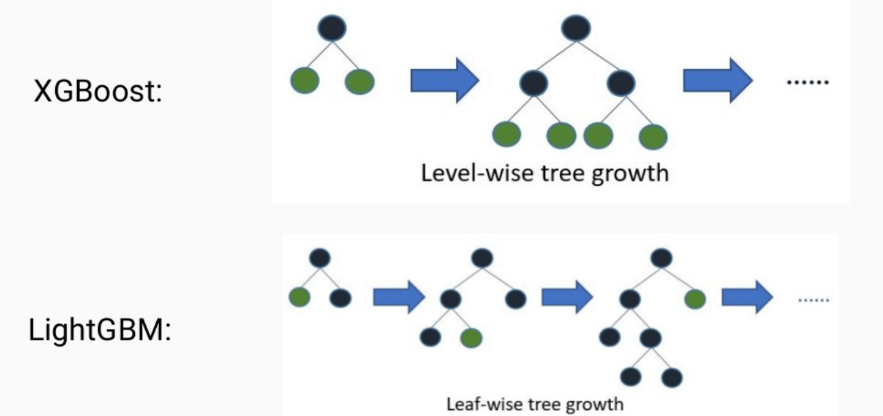
Model
XGBoost or LightGBM?
Framework difference:
XGBoost: level-wise (horizontally)
LightGBM: leaf-wise (vertically)
Computational cost:
LightGBM << XGBoost
Likelihood of overfitting:
LightGBM >> XGBoost
early stopping criteria is required
Notes:
During model development, we have consider XGBoost and LightGBM respectively.
The main difference between them is the way they grow the trees.
XGBoost make use of level-wise tree growth while LightGBM applies leaf-wise tree growth.
Level-wise approach would grow the trees horizontally while leaf-wise would grow vertically.

Slide 24
Model
We choose the model LightGBM
which have the following advantages suggested by the paper
1. Faster training speed and higher efficiency
2. Lower memory usage
3. Better accuracy
4. Support of parallel and GPU learning
Notes:
Finally, we have decided to make use of LightGBM considering various aspects
first of all, it is more efficient which has shorter training time
also, it consumes less memory
and it can yield better accuracy
last but not least, it also enables the feature of parallel computing so we may use GPU to train the model

Slide 25
Model
Accuracy
Boosting type: gradient boosting decision tree
Cross validation: rolling window approach
Learning rate: 0.005
force_col_wise: True
early_stopping_rounds: 50
Notes:
force_col_wise: true
-> prevent memory issue

Slide 26
Model
Uncertainty
28 days ahead probabilistic forecasts for the median and four prediction intervals (50%, 67%, 95%, and 99%).
Our approach:
normal distribution was used to convert the Accuracy prediction into Uncertainty probabilistic prediction
Notes:
For the Uncertainty part,
It refers to 28 days ahead probabilistic forecasts for the median and four prediction intervals.
Our approach:
normal distribution was used to convert the Accuracy prediction into Uncertainty probabilistic prediction

Slide 27
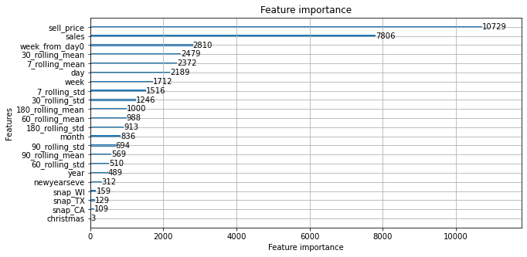
Model
We plot the feature importance chart
The most important features are selling price and sales
Date related features and lag related features are more important than the holiday ones

Slide 28
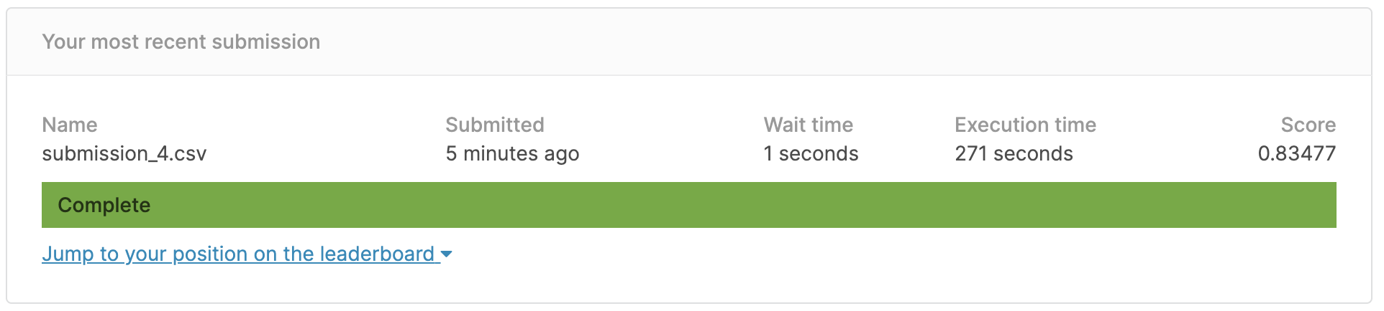
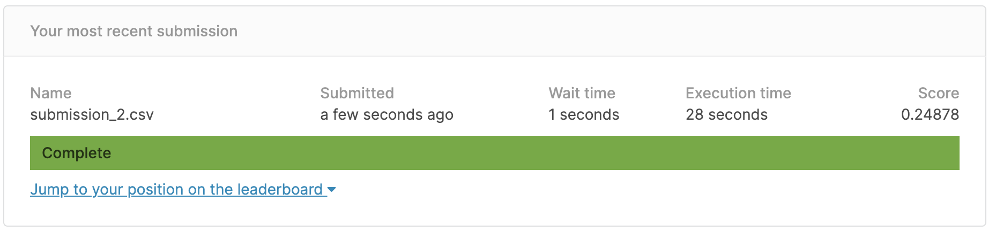
Model Result
Accuracy
Top scores are around 0.56, we get 0.8477
Uncertainty
Top scores are around 0.15, we get 0.24878

Slide 29
Conclusion
Interesting findings
Before introducing lag features, our score was over 1
lag features improved the prediction score to 0.84
Future improvements
we observe some of the models take more than 10 hours or even one day to process
while ours only take about 1 hour
we could add more features e.g. price_lag, max./min. (instead of only mean and std), norm

Slide 30
END

